Slide 1
FRUIT RECOGNITION, QUANTITY AND QUALITY ESTIMATION USING A ROBOTIC VISION SYSTEM
Presented by ,
SAI SADHAN S (312416106085)
SRIRAM M (312416106104)
Guided by ,
Mr. M.V.KARTHIKEYAN,M.E.,
Associate Professor

Slide 2
OBJECTIVES
To recognize the type and to estimate the quantity and quality of fruits.
To detect the disease from the processed image if any.

Slide 3
LITERATURE SURVEY
S.NO. | TITLE OF THE PAPER WITH AUTHOR NAME | JOURNAL NAME | YEAR OF PUBLICATION | METHODOLOGY | PROS & CONS
1 | Michael Halstead, Christopher McCool, Simon Denman, Tristan Perez, Clinton Fookes “Fruit Quantity and Ripeness Estimation Using a Robotic Vision System” | IEEE Robotics And Automation Letters, VOL. 3, NO. 4, OCTOBER 2018 | 2019 | CNN | Uses monocular camera with 3D structuring. Cost of system cannot be controlled and may lead to compromising of system efficiency

Slide 4
S.NO. | TITLE OF THE PAPER WITH AUTHOR NAME | JOURNAL NAME | YEAR OF PUBLICATION | METHODOLOGY | PROS & CONS
2 | Jnaneshwar Das , Camillo J. Taylor, James Underwood “Monocular Camera Based Fruit Counting and Mapping With Semantic Data Association” | IEEE Robotics and Automation Letters, VOL. 4, NO. 3 | 2018 | Faster-RCNN | Uses parallel FRCNN for joint detection. Accuracy is 82.1%

Slide 5
S.NO. | TITLE OF THE PAPER WITH AUTHOR NAME | JOURNAL NAME | YEAR OF PUBLICATION | METHODOLOGY | PROS & CONS
3 | Xu Liu, Steven W. Chen, Shreyas Aditya, Nivedha Sivakumar, Sandeep Dcunha, Chao Qu, Camillo J. Taylor, Jnaneshwar Das, and Vijay Kumar “Robust Fruit Counting: Combining Deep Learning, Tracking, and Structure from Motion” in 2018. | IEEE/RSJ International Conference on Intelligent Robots and Systems (IROS) Madrid, Spain | 2018 | Uses FCN in assocciation with Hungarian algorithm and KLT Tracker. | Can improve counting ability and robustness Error rate is increased from 0.2% to 7.8%

Slide 6
S.NO. | TITLE OF THE PAPER WITH AUTHOR NAME | JOURNAL NAME | YEAR OF PUBLICATION | METHODOLOGY | PROS & CONS
4 | “Automatic dragon fruit counting using adaptive thresholds for image segmentation and shape analysis” Chi Cuong Tran , Dinh Tu Nguyen , Hoang Dang Le , Quoc Bao Truong | 4th NAFOSTED Conference on Information and Computer Science | 2017 | Image segmentation, Boundary determination, Shape analysis, Overlap analysis | Accurate counting of number of fruits per tree. Focus on only one fruit. Not globally applicable

Slide 7
S.NO. | TITLE OF THE PAPER WITH AUTHOR NAME | JOURNAL NAME | YEAR OF PUBLICATION | METHODOLOGY | PROS & CONS
5 | Susovan Jana, Ranjan Parekh “Automatic Fruit Recognition from Natural Images using Color and Texture Features “ | Devices for Integrated Circuit (DevIC), 23-24 March, 2017, Kalyani, India | 2017 | Gray-level Co-occurrence Matrix | Used to predict unlabeled image Detects and predicts images but not actual fruits

Slide 8
S.NO. | TITLE OF THE PAPER WITH AUTHOR NAME | JOURNAL NAME | YEAR OF PUBLICATION | METHODOLOGY | PROS & CONS
6 | Manali R. Satpute ,Sumati M. Jagdale “Automatic Fruit Quality Inspection System “ | IEEE conference | 2016 | Blob detection, Color detection | Replaces manual system Does not inspect fruits bigger than a tomato

Slide 9
S.NO. | TITLE OF THE PAPER WITH AUTHOR NAME | JOURNAL NAME | YEAR OF PUBLICATION | METHODOLOGY | PROS & CONS
7 | Anisha Syal, DivyaGarg, Shanu Sharma “Apple Fruit Detection and Counting Using Computer Vision Techniques “ | IEEE International Conference on Computational Intelligence and Computing Research | 2014 | Minimum Euclidean distance based segmentation technique Fruits are counted on the basis of the centroid of the fruit regions | Correctly detects and counts apples Other fruits are not detected

Slide 10
S.NO. | TITLE OF THE PAPER WITH AUTHOR NAME | JOURNAL NAME | YEAR OF PUBLICATION | METHODOLOGY | PROS & CONS
8 | Hongshe Dang, Jinguo Song, Qin Guo “A Fruit Size Detecting and Grading System Based on Image Processing” | Second International Conference on Intelligent Human-Machine Systems and Cybernetics. | 2010 | Size detecting, Fruit grading, Image processing | High grading accuracy Bulky hardware

Slide 11
EXISTING SYSTEM
The existing system approach consists of two sub-systems:
1.Detection ripeness estimation subsystem
2.Tracking subsystem.
Uses Deep Fruits technique.
Pre-trained FRCNN network (based on the VGG-16 architecture).
The tracking sub-system - tracking via detection approach.
Tracking via detection - a simple framework to count the number of fruits using off-the-shelf cameras.
DISADVANTAGES
Results can vary considerably due to human differences in color perception and human error.
Available light quantity and quality can influence color perception.
Since it uses VGG-16 architecture it’s accuracy is very low.

Slide 12
EXISTING SYSTEM vs PROPOSED SYSTEM
Parameters | Existing system | Proposed system
Algorithm Techniques | VGG-16 The existing system approach consists of two sub-systems: 1.Detection ripeness estimation subsystem 2.Tracking subsystem. Uses Deep Fruits technique. Pre-trained FRCNN network. | CNN-Alexnet The system is divided into the following steps 1.Image acquisition 2. Image Pre-processing 3.Feature Extraction 4.Classification.

Slide 13
PROPOSED SYSTEM
The system is divided into the following steps:
(1) Image acquisition
(2) Image Pre-processing
(3) Feature Extraction
(4) Classification.
Images undergo pre-processing steps - filtering and segmentation using morphological operations.
Texture and color features extracted from the processed image.
Feature extraction - procedure to opt for the important characteristics of an image and transforming input data into set of features.
The key features give specific range for each disease.
Feature values are fed as input to the classifier to classify the given image.

Slide 14
BLOCK DIAGRAM
Alexnet

Slide 15
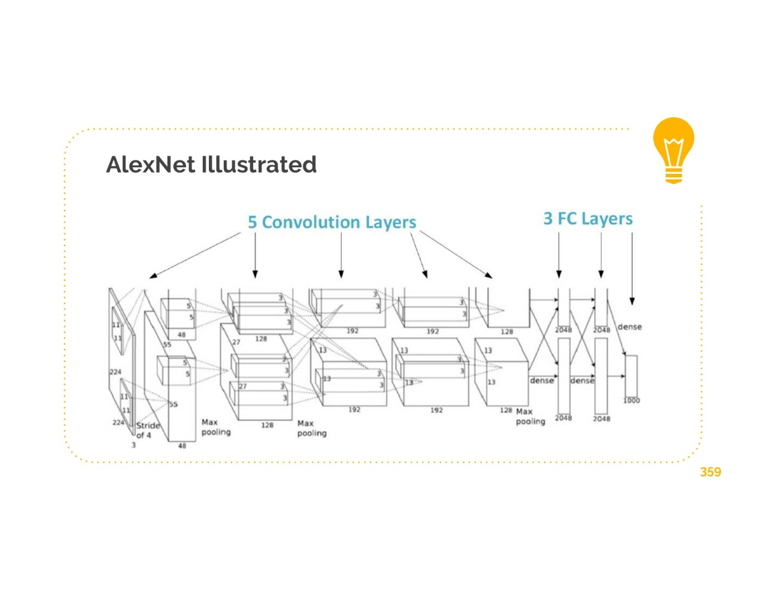
AlexNet architecture

Slide 16
BLOCK DIAGRAM DESCRIPTION
STAGE I(INPUT IMAGE):
The input image will be feed into the system using pi camera.
STAGE II(PREPROCESSING):
It is the preprocessing stage in which the color conversion and filtering of the input image is done to get better accuracy
STAGE III:
In this stage the color enhancement and morphological operations are done with the input image fed to the system.
STAGE IV:
In this stage using Alexnet the required features are extracted from the input image.
Then finally the output will be displayed in the monitor which includes cultivation status and quality and quantity of the fruit.

Slide 17
BLOCK DIAGRAM
Power supply
Raspberry Pi
Humidity sensor
Temperature sensor
Display
OpenCV
Camera

Slide 18
SOFTWARE REQUIREMENTS
Raspbian
Python
Keras
Tensor flow

Slide 19
HARDWARE REQUIREMENTS
Raspberry Pi
Pi-Camera
Power cable
Memory card
Connecting cables
Pi-protection case
Temperature Sensor
Humidity Sensor

Slide 20
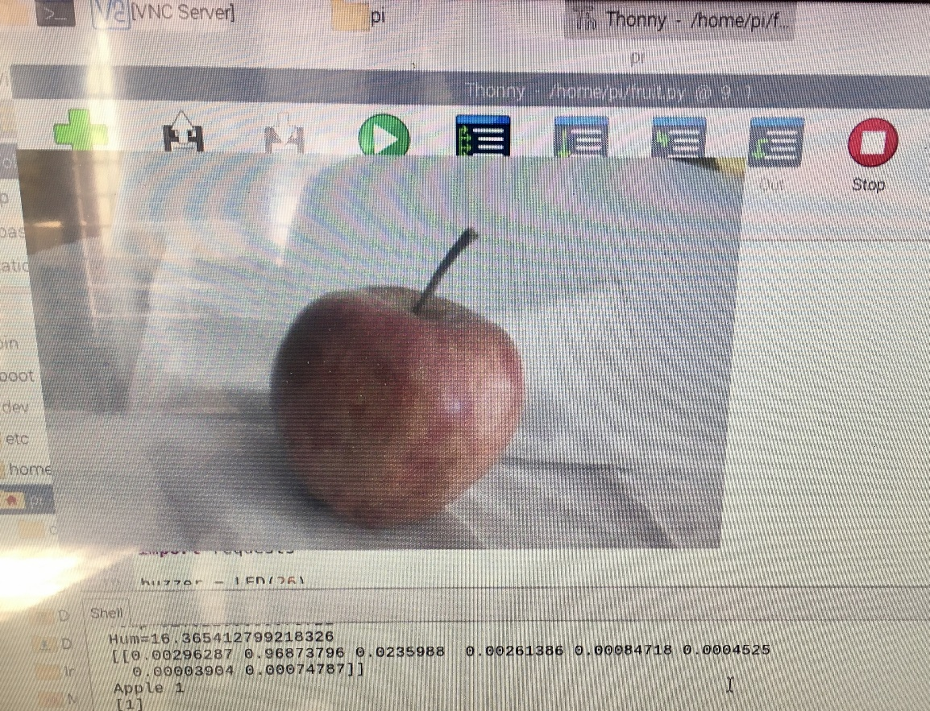
EXPECTED OUTPUT
sample.1 Sample output of the apple
It shows such that “apple=1” the name & count of the fruit in the window

Slide 21
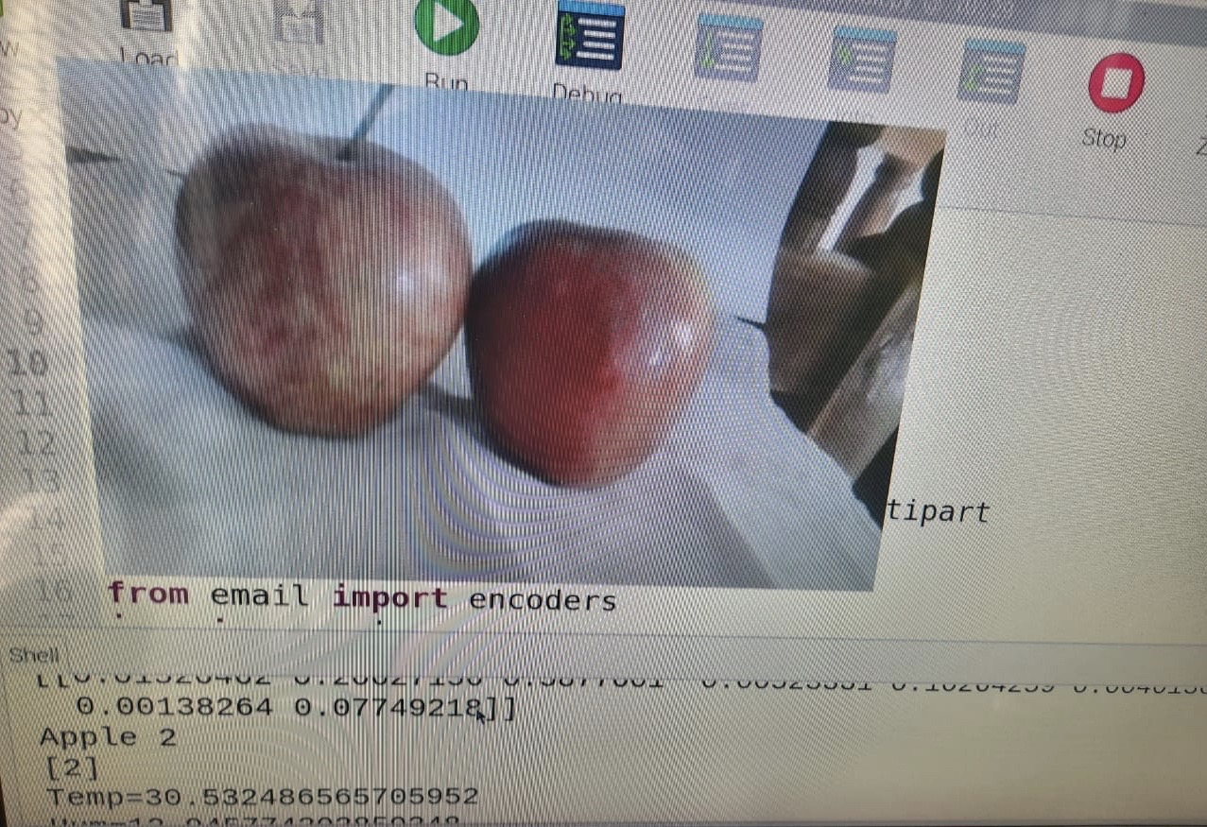
EXPECTED OUTPUT
Sample.2 sample output of two apples
It shows such that “apple=2” the name & count of the fruit

Slide 22
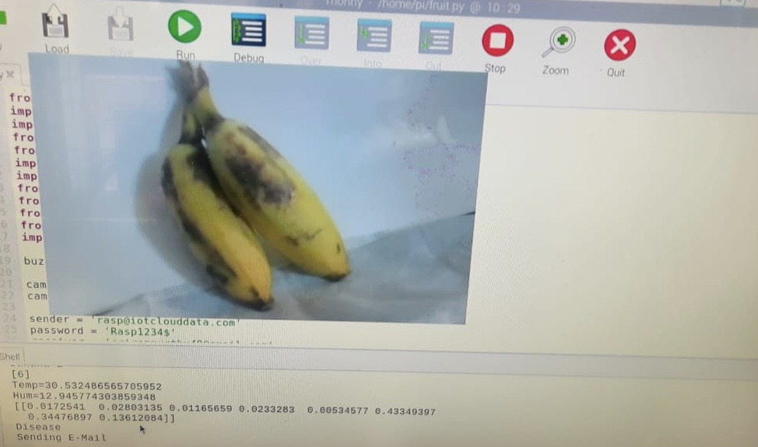
EXPECTED OUTPUT
Sample.3 sample output of two diseased banana
It shows such that “disease” , “sending E-Mail” if fruit is found diseased.

Slide 23
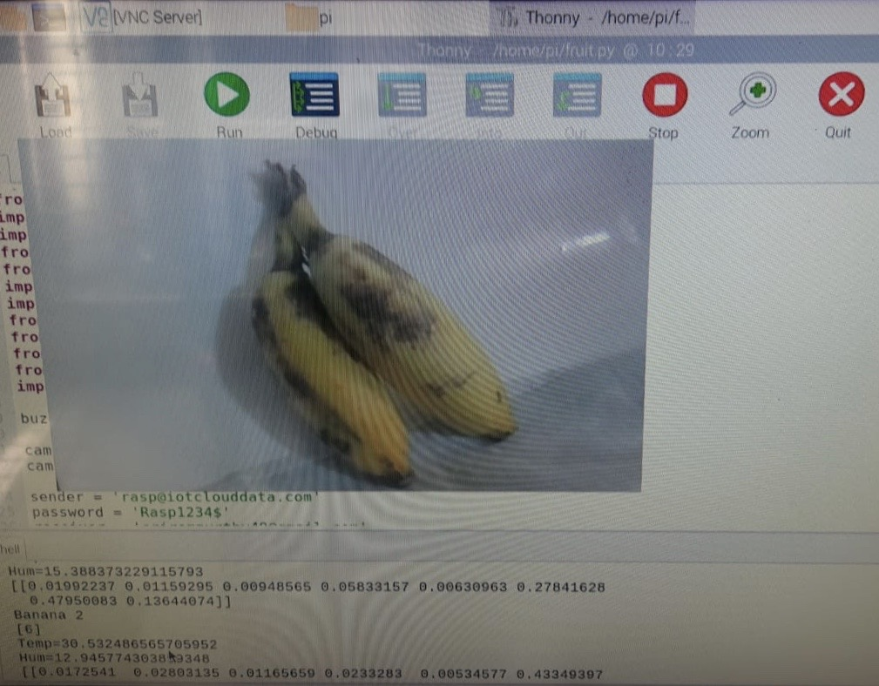
EXPECTED OUTPUT
Sample.4 sample output of two bananas
It shows such that “Banana=2” the name & count of the fruit.
It also shows the “temperature” and “humidity” of the atmosphere.

Slide 24
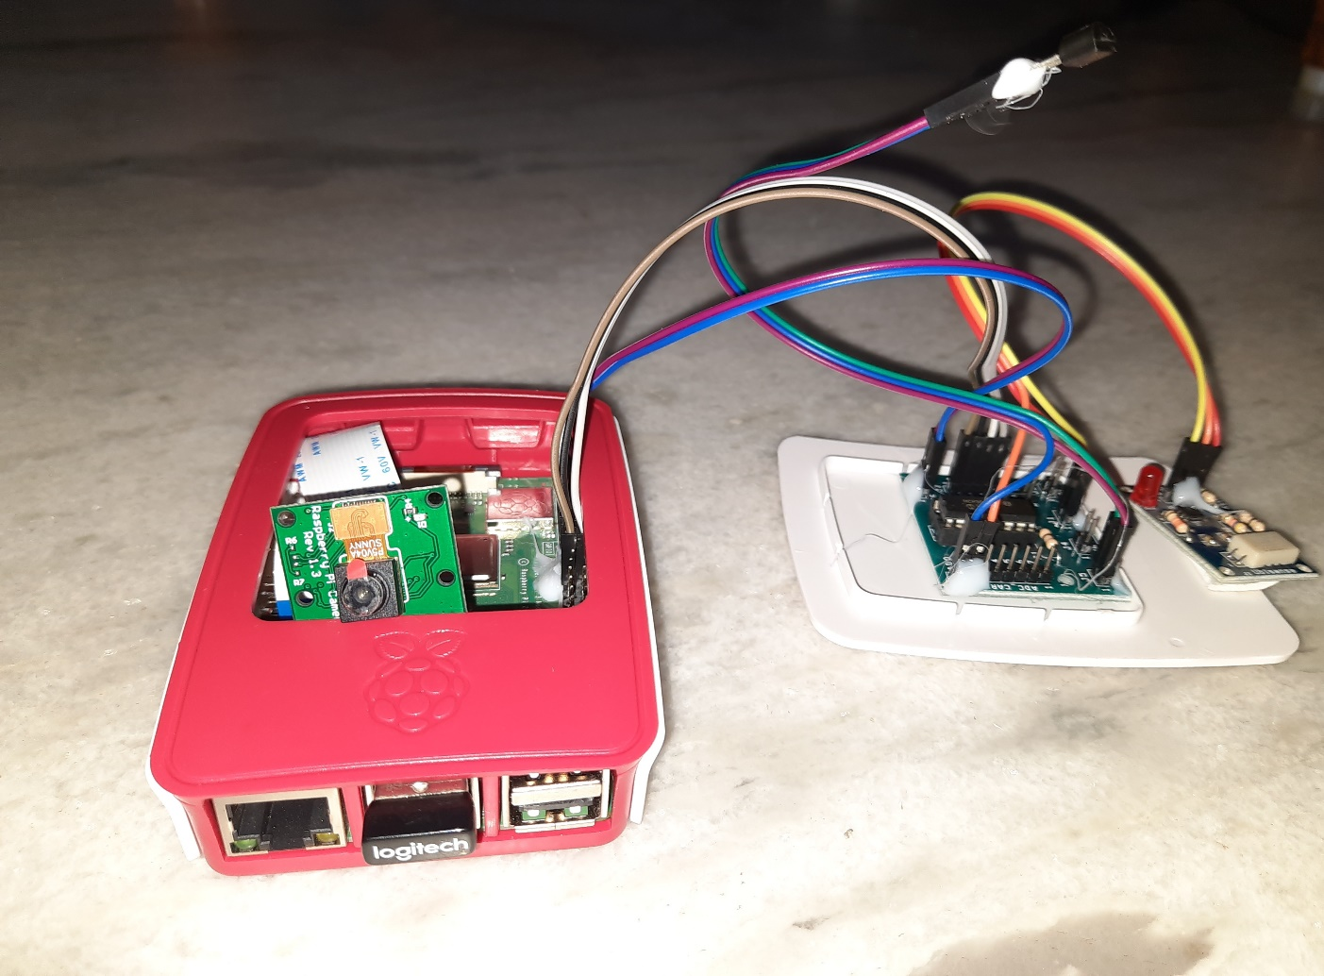
Final product

Slide 25
ADVANTAGES
This method helps in speed up the process and reduce time.
It improve accuracy and efficiency.
Best suited for different illuminant condition.

Slide 26
CONCLUSION
Finally, the feature values are fed as input to the classifier to classify the given image from which the type , quantity and quality of fruits are determined.
The environmental conditions are closely monitored and actions are taken if necessary.

Slide 27
APPLICATIONS
In the food industry to segregate healthy fruits from diseased fruits and can only the healthy fruits be further processed.
Harvesting Good and healthy fruits in the farm.
Segregating fruits based on quality and grade for marketing.
Grouping fruits according to quality for export

Slide 28
Future enhancement
For future enhancement to this project, the trained data can be tuned further and the extraction of more features other than that are mentioned in abover report will assist in increasing the prediction accuracy.
The enhanced one will be as bot version in which the product is incorporated.
There will also be software user interface in the mobile application paltforms for the user convenience.

Slide 29
REFERENCES
[1] Michael Halstead , Christopher McCool , Simon Denman , Tristan Perez , and Clinton Fookes “Fruit Quantity and Ripeness Estimation Using a Robotic Vision System” IEEE ROBOTICS AND AUTOMATION LETTERS, VOL. 3, NO. 4, OCTOBER 2018
[2] Jnaneshwar Das , Camillo J. Taylor, James Underwood “Monocular Camera Based Fruit Counting and Mapping With Semantic Data Association” in IEEE ROBOTICS AND AUTOMATION LETTERS, VOL. 4, NO. 3, JULY 2019
[3] Xu Liu, Steven W. Chen, Shreyas Aditya, Nivedha Sivakumar, Sandeep Dcunha, Chao Qu, Camillo J. Taylor, Jnaneshwar Das, and Vijay Kumar “Robust Fruit Counting: Combining Deep Learning, Tracking, and Structure from Motion” in 2018 IEEE/RSJ International Conference on Intelligent Robots and Systems (IROS) Madrid, Spain, October 1-5, 2018.

Slide 30
[4] Chi Cuong Tran , Dinh Tu Nguyen , Hoang Dang Le , Quoc Bao Truong “Automatic dragon fruit counting using adaptive thresholds for image segmentation and shape analysis” in 2017 4th NAFOSTED Conference on Information and Computer Science
[5] Susovan Jana, Ranjan Parekh “Automatic Fruit Recognition from Natural Images using Color and Texture Features “in 2017 Devices for Integrated Circuit (DevIC), 23-24 March, 2017, Kalyani, India.
[6] Manali R. Satpute ,Sumati M. Jagdale “Automatic Fruit Quality Inspection System “ in 2016 IEEE conference.
[7] Anisha Syal, DivyaGarg, Shanu Sharma “Apple Fruit Detection and Counting Using Computer Vision Techniques “in 2014 IEEE International Conference on Computational Intelligence and Computing Research
[8] Hongshe Dang, Jinguo Song, Qin Guo “A Fruit Size Detecting and Grading System Based on Image Processing”in 2010 Second International Conference on Intelligent Human-Machine Systems and Cybernetics.

